Slide 1
Web ‘Dasar’ {
webdasar.html
webdasar.css
[#4 : Basic CSS]
< Maresha Caroline, Sulaeman Santoso >
}
Fakultas Teknologi dan Rekayasa Cerdas

Slide 2
Today’s ‘Topic’ {
forbeginners.html
workshop.css
CSS syntax
CSS usage
CSS selector
Some common basic css
}
Programming Language

Slide 3
What is ‘CSS’ {
forbeginners.html
workshop.css
HTML is not enough to specify formatting for a document rather than its contents
Formatting tags/attribute such as <font> or color makes the page harder to read and longer not to mention annoying
CSS defines HOW HTML elements are to be displayed
}
Programming Language

Slide 4
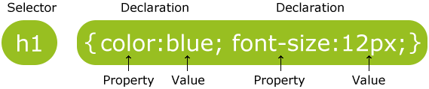
CSS ‘syntax’{ how to write your css code
}

Slide 5
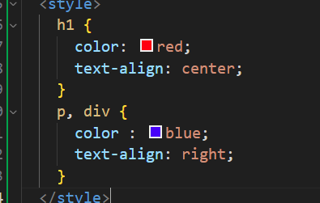
CSS‘Selector’ {
forbeginners.html
workshop.css
Selector could be
A html tag
A class
An Id
Selector can also be grouped
}
Programming Language

Slide 6
Include ‘CSS’ {
forbeginners.html
workshop.css
External stylesheets
Write css on external file, with .css extension
E.g. : <link rel="stylesheet" href="style.css">
Internal Stylesheets
Write css within the html file within <head>
E.g. : <style>h1 {color: red;}</style>
Inline style
Inside the html tag in question
E.g. : <h1 style="color: blue;">css rock</h1>
}
Programming Language

Slide 7
Multiple ‘CSS Style ’ {
forbeginners.html
workshop.css
Note : when multiple rules are applied to the same element the more specific one will win
From order of priority
Inline style
Internal style
External style
Browser default
}
Programming Language

Slide 8
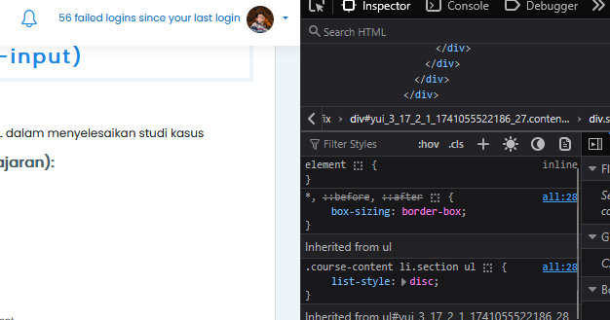
CSS ‘checks’{ you can view css through your browser
}

Slide 9
CSS ‘background prop’ {
forbeginners.html
workshop.css
To define background effect on an element
background-color
Hexa value (#ff00ff), RGB value (rgb(255,0,0)), color name (red)
background-image
url (‘’)
background-repeat
No-repeat, repeat-x, repeat-y,repeat(default)
background-attachment
Scroll, fixed
background-position
hpos[left,right,center] vpost[top, center,bottom],
%x %y, xpos ypos
}
Programming Language

Slide 10
CSS ‘background prop’ {
forbeginners.html
workshop.css
background-size
Px or %
background-clip
Border-box, padding-box, content-box;
-webkit-background-clip:content-box; /* Safari */
Background-origin
Border-box, padding-box, content-box;
}
Programming Language

Slide 11
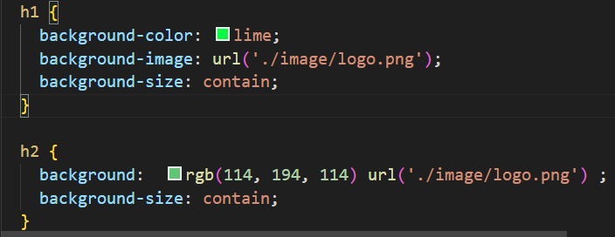
CSS ‘shorthand prop’ {
forbeginners.html
workshop.css
}
Programming Language

Slide 12

CSS ‘Box Model’ {
forbeginners.html
workshop.css
}
Programming Language

Slide 13
CSS‘Padding’ {
forbeginners.html
workshop.css
Padding property
Padding-top
Padding-right
Padding-bottom
Padding-left
Padding : 25px (all padding 25px)
Padding : 10px 20px (vertical and horizontal)
Padding : 10px 20px 30px 40px
}
Programming Language

Slide 14
CSS‘Margin’ {
forbeginners.html
workshop.css
Margin property
Margin-top
Margin-right
Margin-bottom
Margin-left
}
Programming Language

Slide 15
CSS‘Width and height’ {
forbeginners.html
workshop.css
Property :
Height
Max-height
Min-height
Width
Max-width
Min-width
Height
Width
}
Programming Language

Slide 16
CSS‘Text property’ {
forbeginners.html
workshop.css
Color : web color
Direction : [ltr,rtl]
Letter-spacing : [normal, length]
Line-height : [ 1-4,length,%]
Text-align [left,right,center,justify]
Text-decoration : [underline,overline,line-through, blink,none]
Text-indent : [length, %]
Text-transform : [none, capitalize, uppercase, lowercase]
Vertical-align : [length, %, baseline, sub, super, top, text-top, middle, bottom, text-bottom]
White-space : [normal, nowrap, pre, pre-wrap, pre-line]
Word-spacing :[normal, length]
}
Programming Language

Slide 17
CSS‘Font property’ {
forbeginners.html
workshop.css
Font-family
Family-name, generic-family
Font-size
xx-smaller,x-smaller,small, medium,larger,x-larger,xx-larger,%,px
Font-variant
Normal, small-caps
Font-weight
Normal, bold, bolder, lighter, 100-900
}
Programming Language

Slide 18
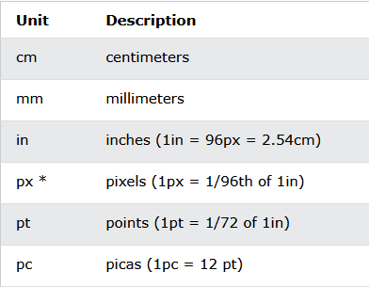
CSS‘absolute unit’ {
forbeginners.html
workshop.css
}
Programming Language

Slide 19
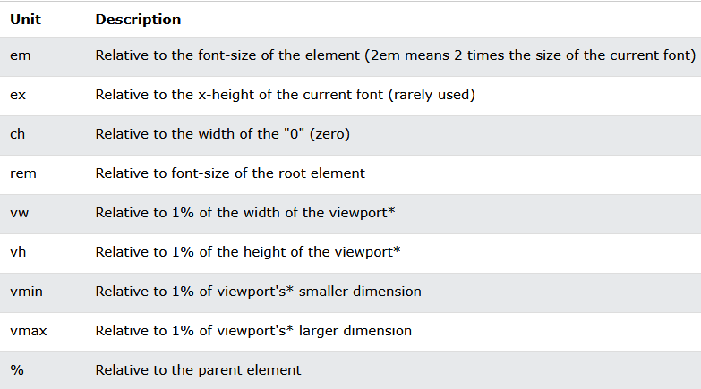
CSS‘relative unit’ {
forbeginners.html
workshop.css
}
Programming Language

Slide 20
CSS‘Link’ {
forbeginners.html
workshop.css
Link has 4 state
a:link – normal unvisited link
a:visited – link after visited
a:hover – link when mouse is hovering
a:active – link when activated
}
Programming Language

Slide 21
CSS‘Link’ {
forbeginners.html
workshop.css
Link has 4 state
a:link – normal unvisited link
a:visited – link after visited
a:hover – link when mouse is hovering
a:active – link when activated
Example : a:link { font-size : 2em;}
}
Programming Language

Slide 22
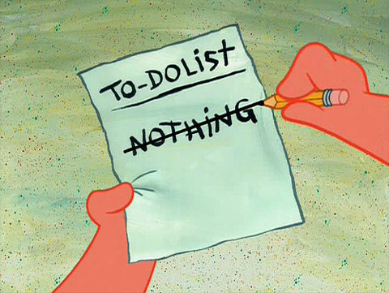
CSS‘List’ {
forbeginners.html
workshop.css
List-style-image : [url,none]
List-style-position : [inside,outside]
List-style-type : [disc, square, lower-greek, hiragana, etc]
Shorthand :
List-style
}
Programming Language

Slide 23
CSS‘table’ {
forbeginners.html
workshop.css
Table border : [ size type color]
Width, height : [size, %]
Border-collapse :[ collapse]
}
Programming Language

Slide 24
CSS‘id / class’ {
forbeginners.html
workshop.css
In addition to adding style to html element
You can also specify style for your own selector
Namely id & class
Id is meant for specific instance of element
Class is meant for a group of element
}
Programming Language

Slide 25
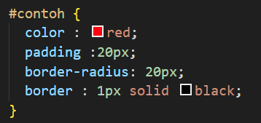
CSS‘id’ {
forbeginners.html
workshop.css
}
Programming Language

Slide 26

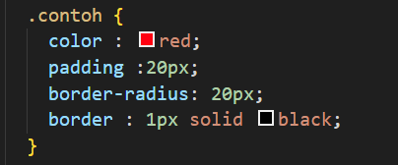
CSS‘class’ {
forbeginners.html
workshop.css
}
Programming Language

